Slide 1

Technical investigation Y:
valve characterisation
Group L

Slide 2

Problem
Our supplier mixed up the specifications of different valves
We have been given one of these valves
We must characterise the valve

Slide 3
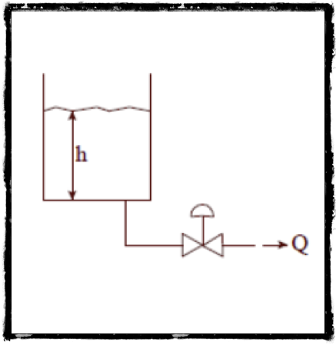
Angle of Attack
Set up a valve tank system
Run 5 experiments at different valve opening settings
Measure flow rate at different heights for each experiment as the tank is emptying
Calculate the average k value
Assume water with SG = 1 (4 degrees)

Slide 4
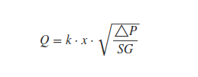

Equations
Where

Slide 5
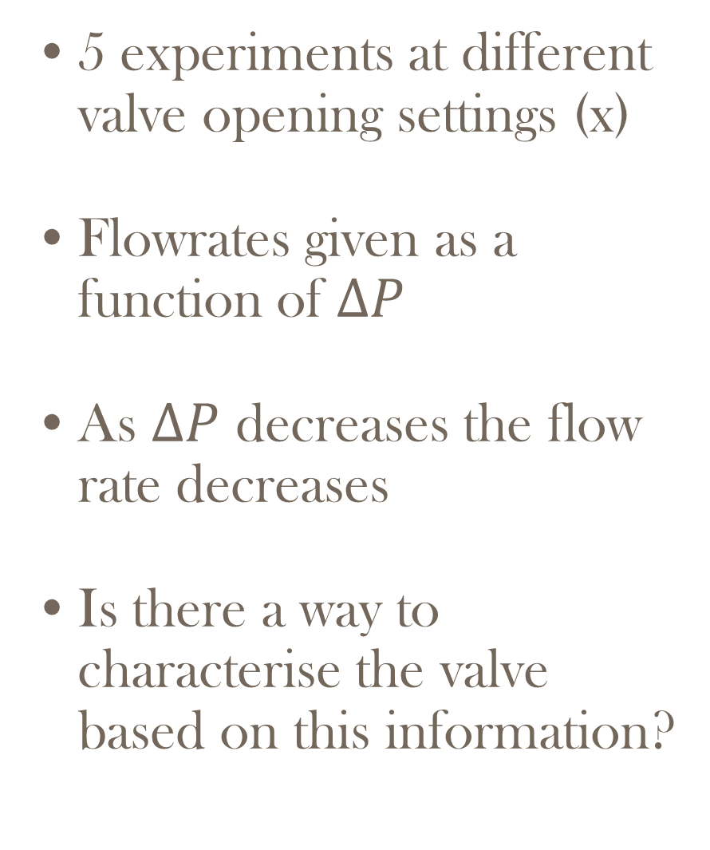
Results
5 experiments at different valve opening settings (x)
Flowrates given as a function of $∆P$
As $∆P$ decreases the flow rate decreases
Is there a way to characterise the valve based on this information?

Slide 6

Results

Slide 7
Results
Data extracted from graph on the previous slide
k is a parameter that characterises the value.

Slide 8
Results
Confirmation of a constant k value for the graph at different opening settings

Slide 9


